Slide 1
AWS Presentation TEAM-5
Instructor: Lavish Arora

Slide 2
AWS Cloud Monitoring:
AWS Cloud Monitoring involves using various AWS services to track and manage the performance, health, and security of your AWS resources and applications.
It helps to ensure that applications are running smoothly, resources are utilized efficiently, and potential issues are identified and resolved promptly.
AWS Monitoring Services include:
Amazon CloudWatch
Amazon CloudTrail

Slide 3
Amazon CloudWatch:
Amazon CloudWatch is a monitoring and management service for AWS resources and applications. It provides data and actionable insights to monitor applications, understand and respond to system-wide performance changes, optimize resource utilization, and get a unified view of operational health.
Key features of Amazon CloudWatch include:
1.CloudWatch Metrics
2. CloudWatch Alarms
3. CloudWatch Logs
4. CloudWatch Events
5. CloudWatch Dashboards

Slide 4
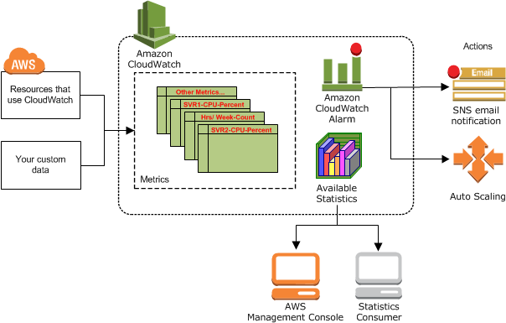

Slide 5
Benefits of AWS CloudWatch:
Monitoring and Alerts: Real-time monitoring of AWS resources and applications, with customizable dashboards and alerts.
Logs Management: Collects and analyzes log data from AWS services and applications.
Performance Insights: Provides metrics, alarms, and automated actions to optimize performance and manage operational health.

Slide 6
Amazon CloudTrail:
AWS CloudTrail is a service that enables governance, compliance, and operational and risk auditing of your AWS account. With CloudTrail, you can log, continuously monitor, and retain account activity related to actions across your AWS infrastructure. CloudTrail provides event history of your AWS account activity, including actions taken through the AWS Management Console, AWS SDKs, command line tools, and other AWS services.
Key features of AWS CloudTrail include:
1.Event Logging
2.Event History
3.Multi-Region Configuration
4.CloudTrail Insights
5.Integration with AWS Services

Slide 7
Benefits of AWS CloudTrail:
Detailed API Activity Logging: Logs all API calls across your AWS account for governance, compliance, and auditing.
Security and Compliance: Helps meet regulatory requirements with detailed records of account activity and log file integrity validation.
Incident Response: Facilitates troubleshooting, security investigations, and forensic analysis by providing a history of API calls.

Slide 8
Case Study: Create and monitor multiple instances for various branches of a Company using AWS:
Step1: To create multiple instances we need to create a VPC(Virtual private network).A single VPC is enough for multiple instances , so first we need to create a VPC.​
Step2:Create VPC ,subnets, internet gateway, route table and flow log.
Step3:As we need multiple instances there are 2 ways: a)To increase the number of instances while creating the EC2 . b)To create Auto Scaling Group(it is better to create ASG for creating multiple instances).​
Step4:ASG first create a template and then create ASG as per the requirements.​
Step5:After creating ASG automatically multiple instances will be created for multiple subnets.​
Step6:After multiple instances got created for multiple subnets, now create IAM users for each instances separately .​
Step7:Giving EC2 Full Access and S3 Full Access while creating the IAM for each instance.​
Step8:Now creation of CloudWatch and CloudTrail.

Slide 9
Total price stated for the above Case Study:​ ​ ​ ​
To calculate the total cost ,open AWS Billing cost and Management and then open AWS Pricing Calculator.​
Using following steps, you can accurately estimate the costs associated with running EC2 instances, setting up an auto-scaling group, creating a VPC, managing IAM users with full access to EC2 and S3 CloudWatch and CloudTrail.​
​

Slide 10
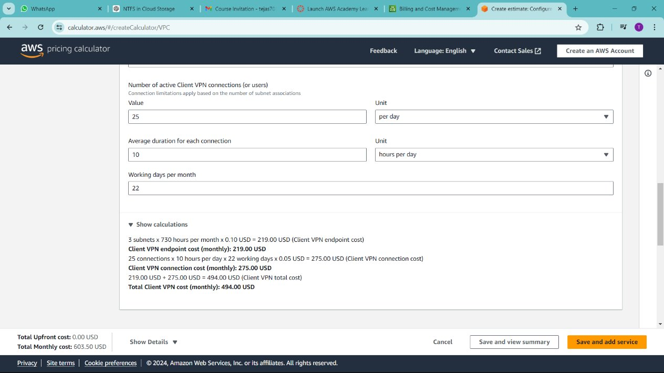
VPC :​ Number of VPCs: 1​ Subnets: 2​ Internet Gateways: 1​ Route tables:1​ Data Transfer: Estimate based on expected usage​ Total client VPN cost(monthly):494.00 USD​

Slide 11
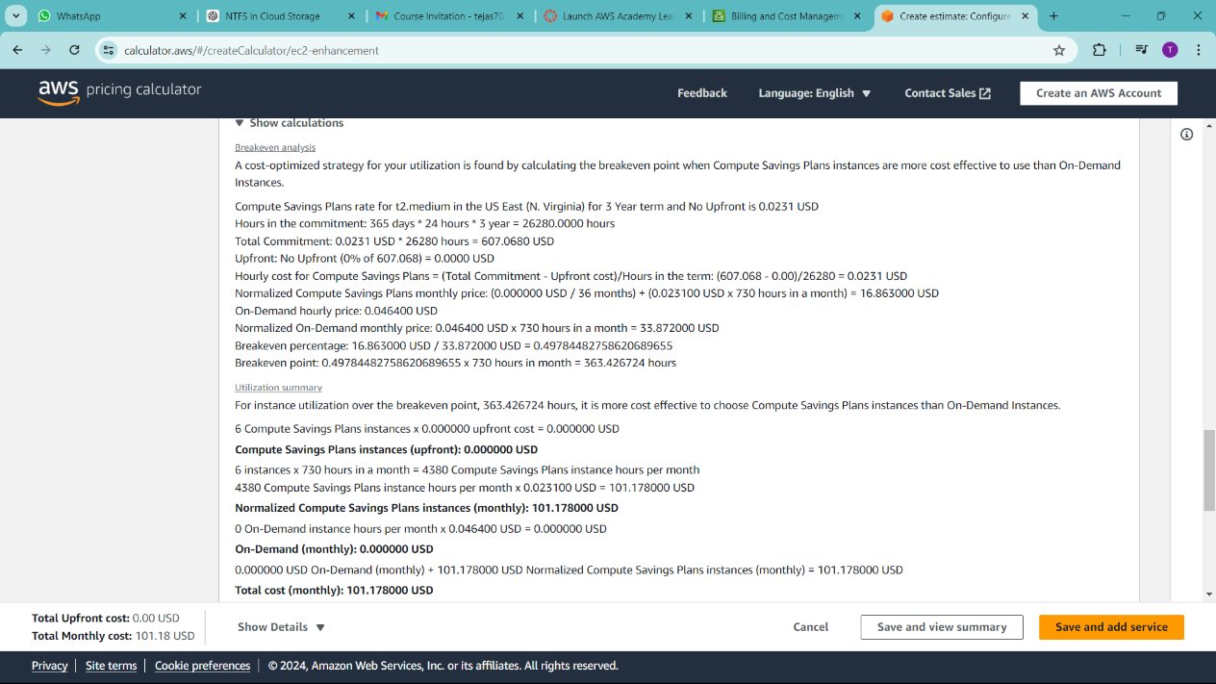
Auto Scaling Group :​ Instance Type: t3.micro​ Desired Capacity: 6​ Minimum Size: 1​ Maximum Size: 10​ Scaling Policies: Simple scaling​ Total cost(monthly):101.178000 USD​

Slide 12
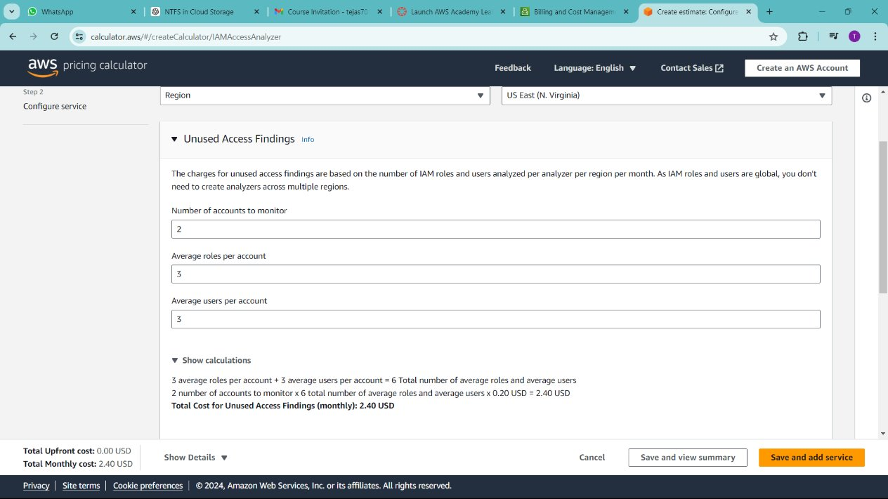
IAM Users ​ Number of Users: 6​ Policies: Full access to EC2 and S3​ ​

Slide 13
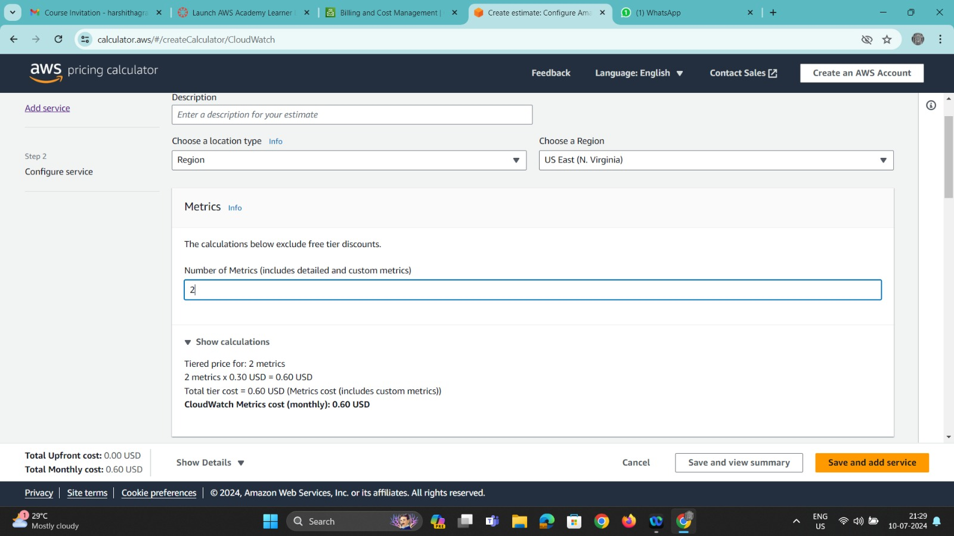
CloudWatch Number of metrics:2 Total cost (monthly)=0.60 USD

Slide 14
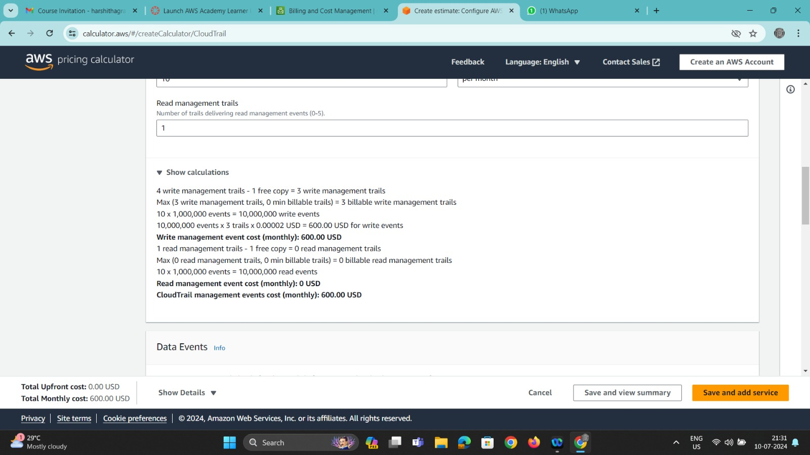
CloudTrail Total cost(monthly):600.00 USD

Slide 15
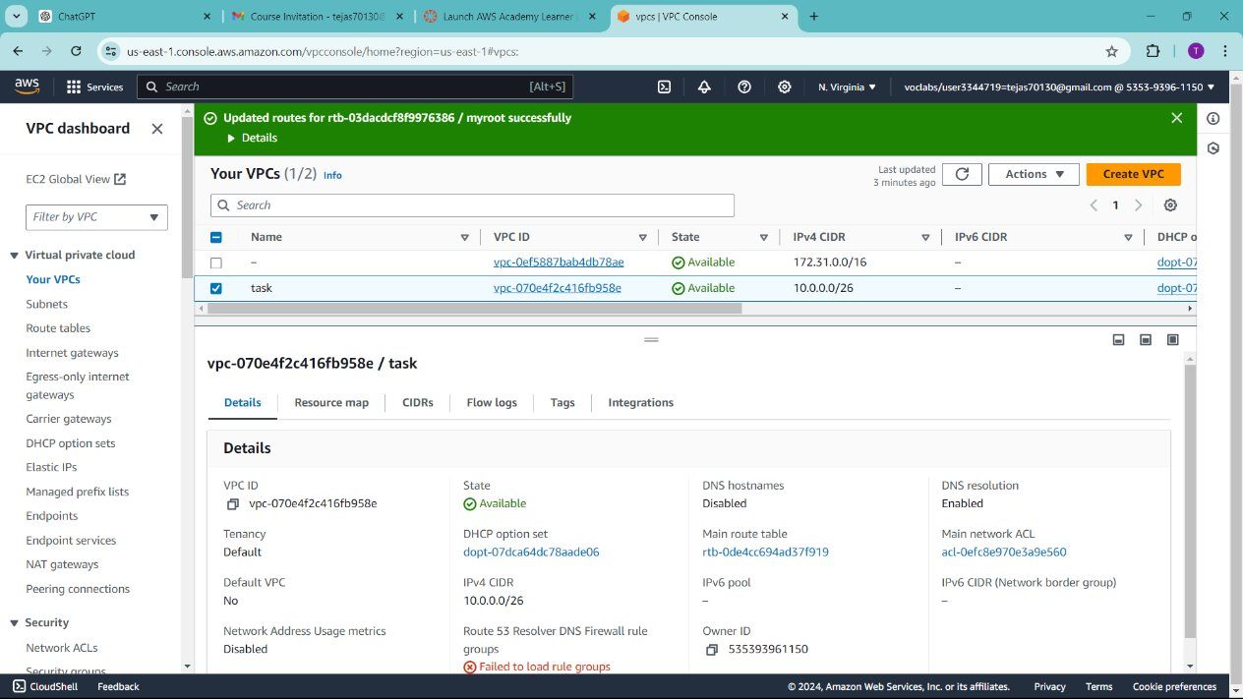
Creation of VPC:

Slide 16
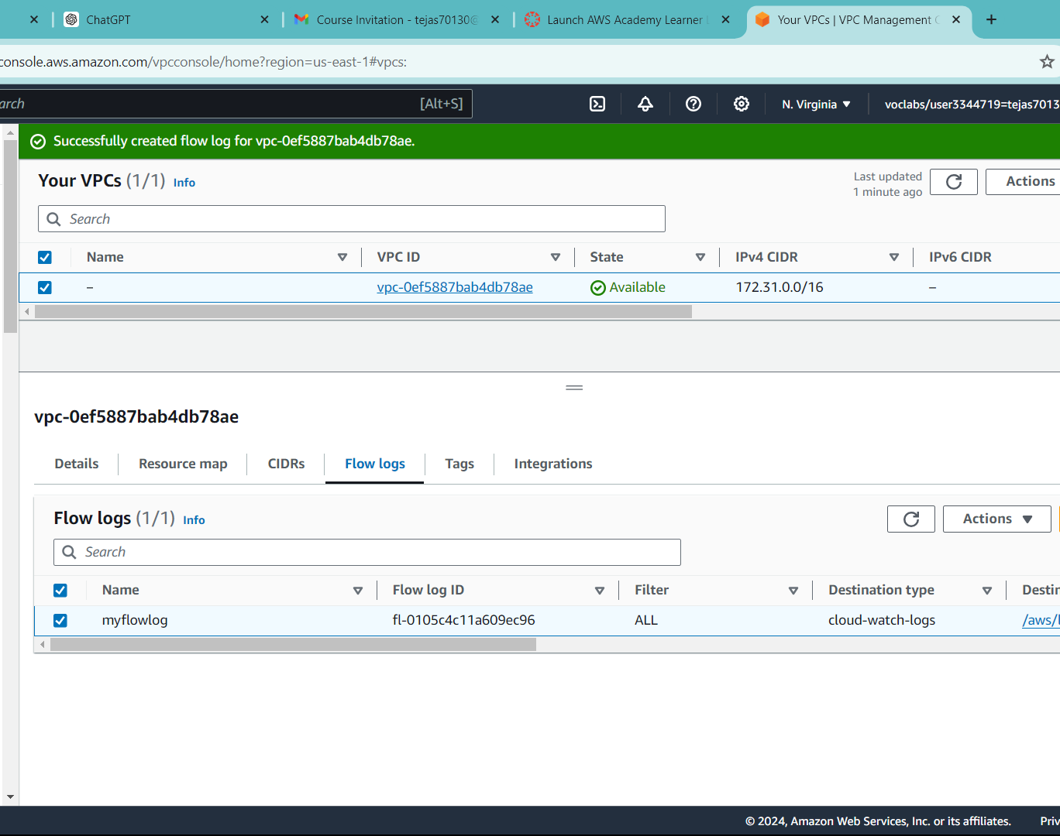
Creation of VPC flow log :
Amazon VPC Flow Logs is a feature that allows you to capture information about the IP traffic going to and from network interfaces in your VPC.
1.Open AWS VPC
2.Create a new VPC
3.Select the created VPC and go to Flow log
4.Select create flow log
5.Enter a unique name to flow log and configure .
6.Create flow log.

Slide 17
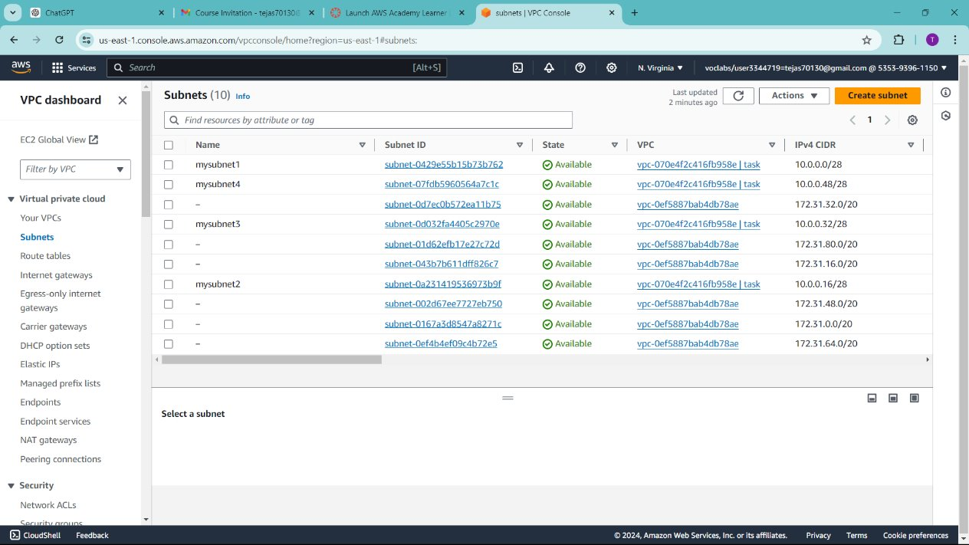
Creation of Subnets:

Slide 18
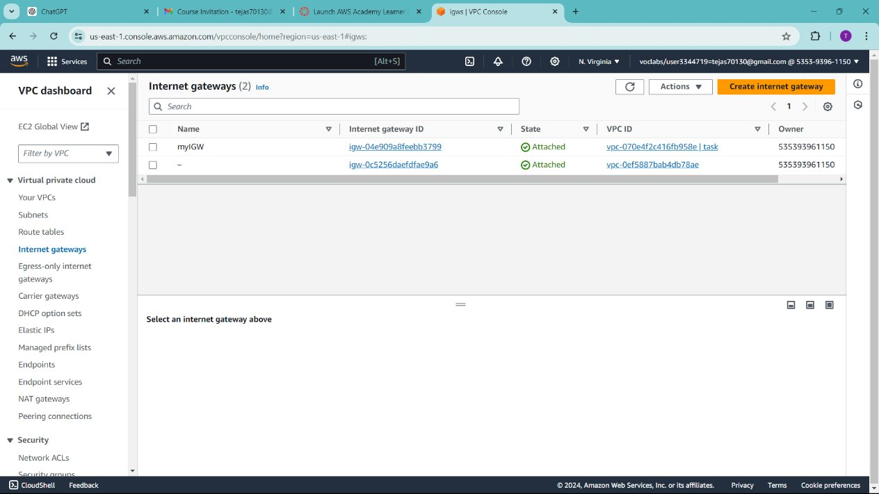
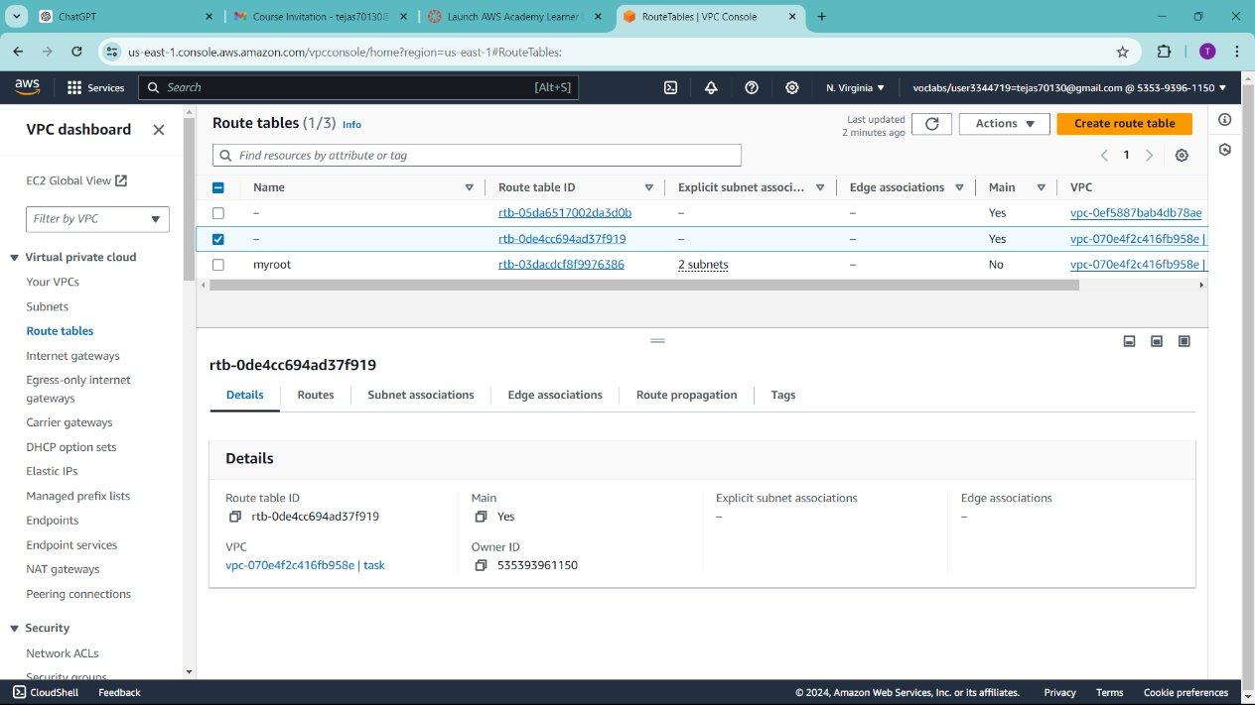
Creation of Internet Gateway and Route Table:

Slide 19
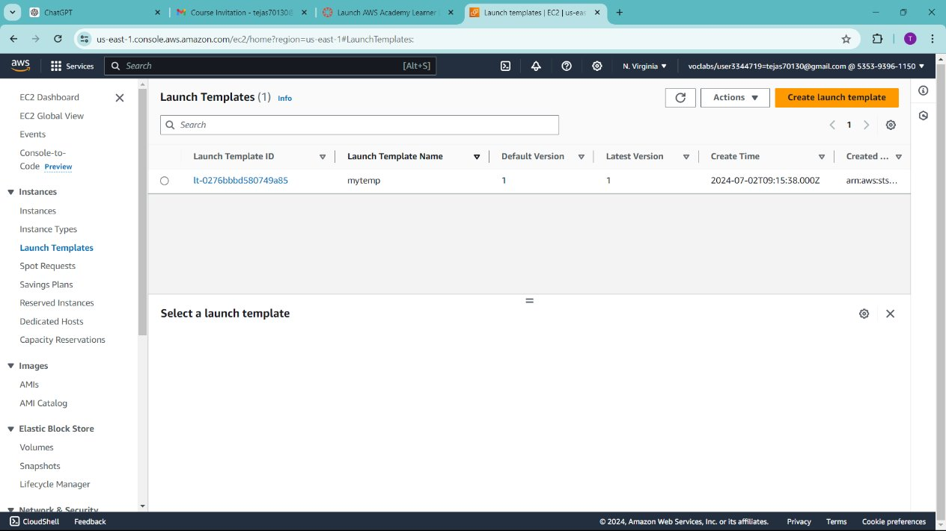
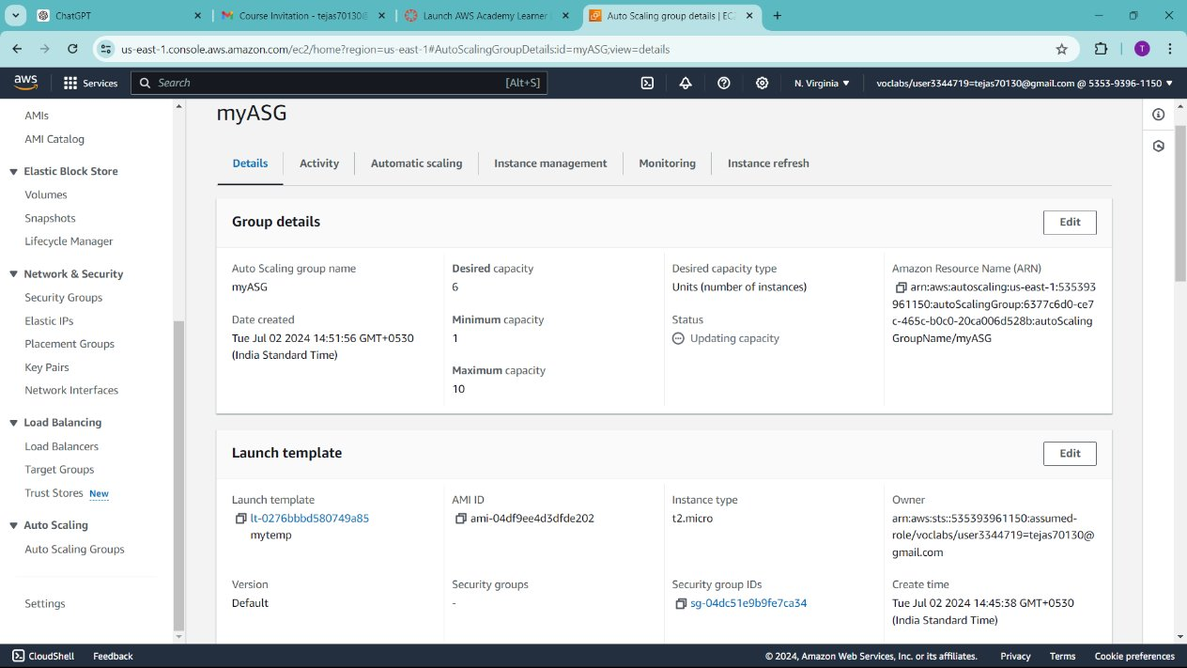
Creation of Template and Auto Scaling Group :

Slide 20
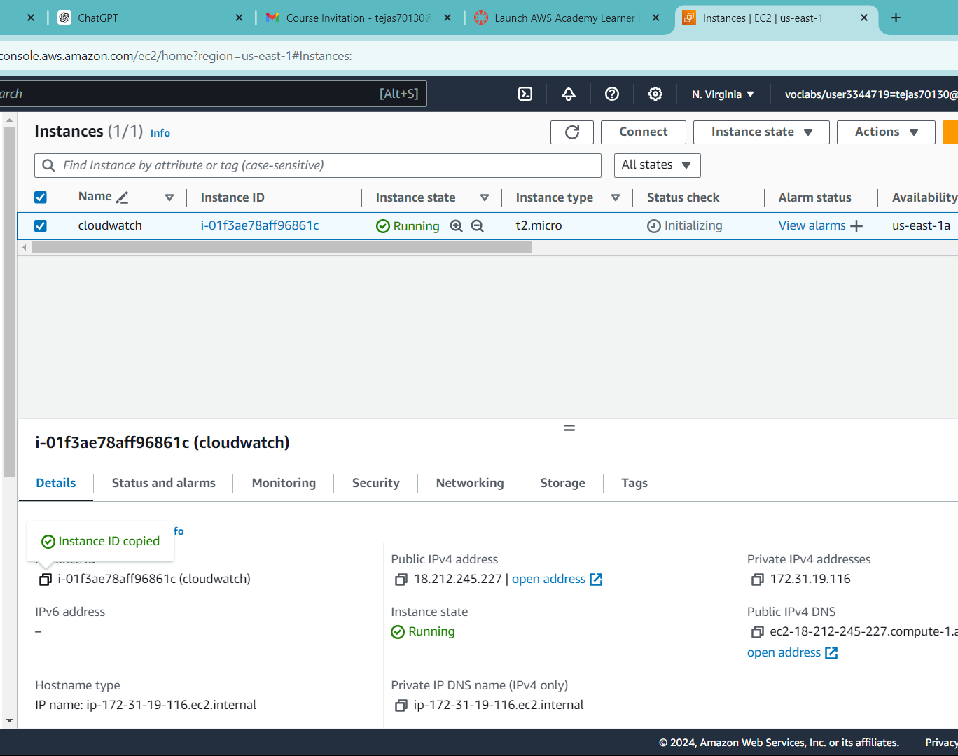
After creation of ASG ,multiple instances are created automatically. Select the created instance and copy the instance unique ID.

Slide 21
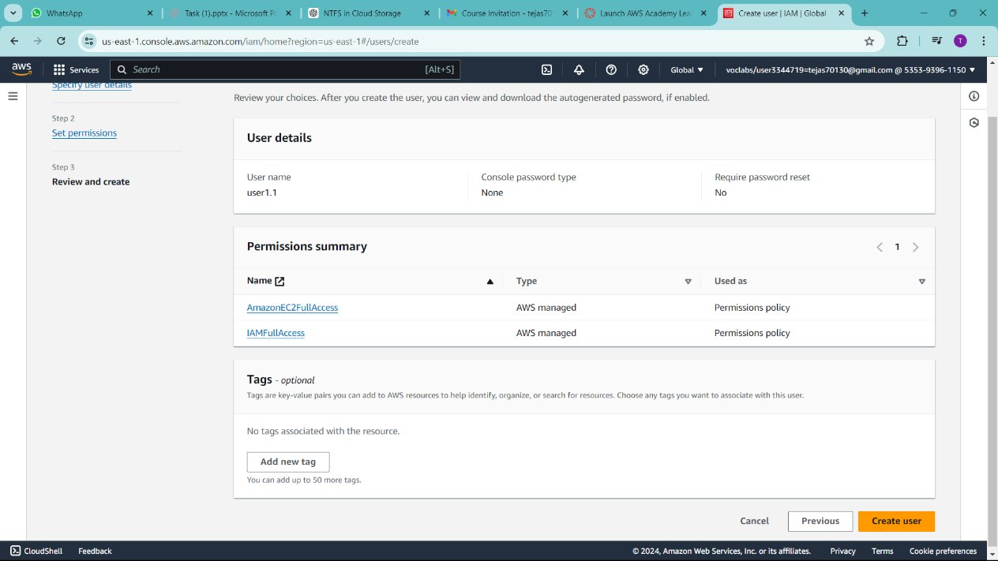
Creation of IAM with EC2 Full Access and S3 Full Access.

Slide 22
Sequence for Amazon CloudWatch Practical:
1. Create VPC > Create Flow Log.
2. Create EC2 instance > Copy the instance ID .
3. Open CloudWatch console.
4. Create a CloudWatch Dashboard > Add widgets (Line) > Add query (EC2)> Browse enter the EC2 instance id > Click Create Dashboard.
5. Set up CloudWatch Alarm > Create Alarm > Add query > Enter metrics (instance id) > Configure Alarm > Click create.
6. Enable CloudWatch Logs > Create Log groups > Configure your AWS resources to send logs to the log group (EC2 instance) > Create log.
7. Set up CloudWatch Events(Event Bridge) > Create rule > Define the event source and pattern > Configure the target for the rule > Create rule to enable the event rule.

Slide 23
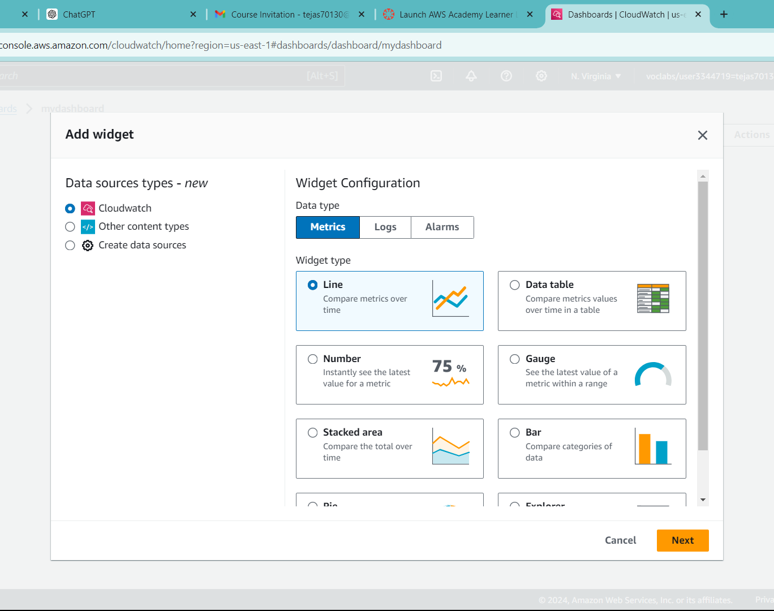
Setting Up Basic CloudWatch Monitoring:
Create a CloudWatch Dashboard :
1. In the CloudWatch console, choose
Dashboards in the navigation pane.
2. Click Create dashboard.
3. Enter a name for your dashboard and click
Create dashboard.
4. Add widgets to the dashboard by selecting
the type of widget (e.g., Line, Stack, Number)
and specifying the metrics you want to display.

Slide 24
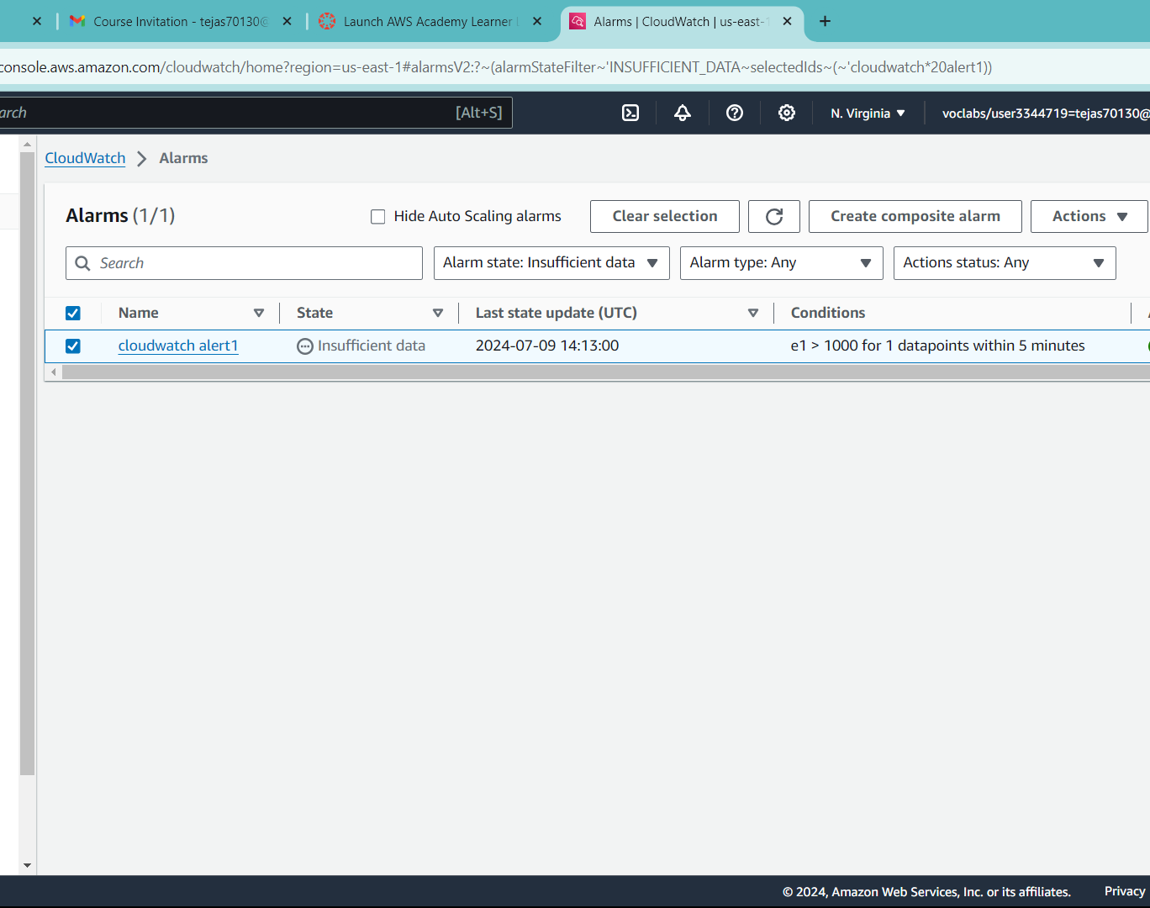
Set Up CloudWatch Alarms
1. In the CloudWatch console, choose Alarms in the navigation pane.
2. Click Create alarm.
3. Select a metric by browsing through the available metrics or searching for a specific metric.
4. Configure the alarm by setting the conditions (e.g., threshold value) and actions (e.g., sending an SNS notification).
5. Review the alarm configuration and click Create alarm.

Slide 25
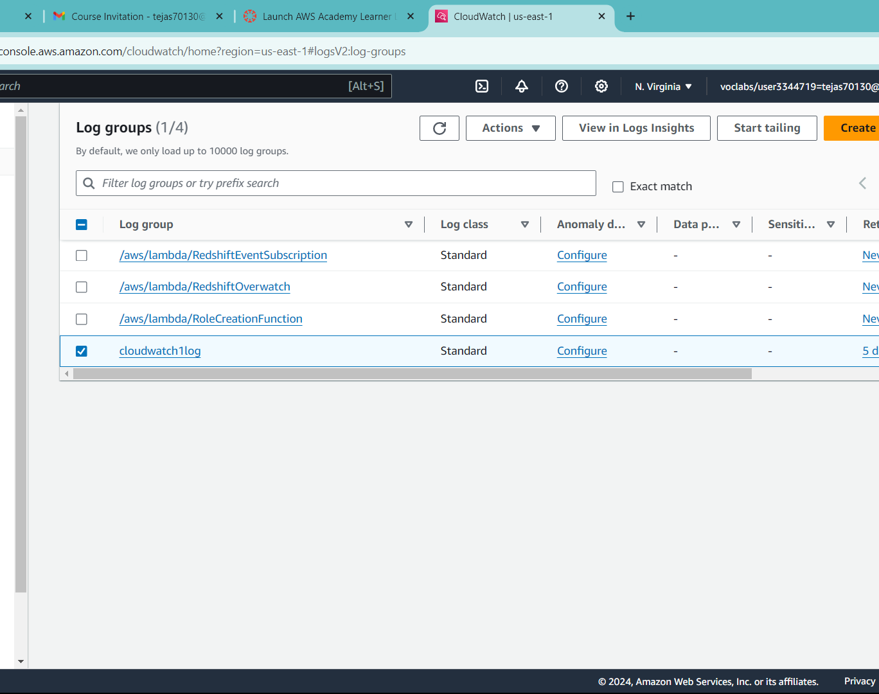
Enable CloudWatch Logs
In the CloudWatch console, choose Logs in the navigation pane.
Click Create log group to organize your log streams.
Configure your AWS resources to send logs to the log group. For example, you can configure EC2 instances, Lambda functions, or other services to send logs to CloudWatch Logs.

Slide 26
Sequence for AWS CloudTrail Practical:
Open the CloudTrail console.
Create Trail
Specify Trail settings >Storage Location >Log File SSE-KMS Encryption >Log File Validation(for the integrity of your log files)
Configure Events >Management Events >Data Events >Insights Events
Review and Create

Slide 27
CONCLUSION:
AWS CloudWatch and CloudTrail complement each other by providing comprehensive monitoring, logging, and auditing capabilities. CloudWatch offers real-time performance monitoring and alerting, while CloudTrail ensures detailed activity logging and compliance tracking. Together, they enhance security, operational efficiency, and governance in your AWS environment.

Slide 28
THANK YOU

